Slide 1
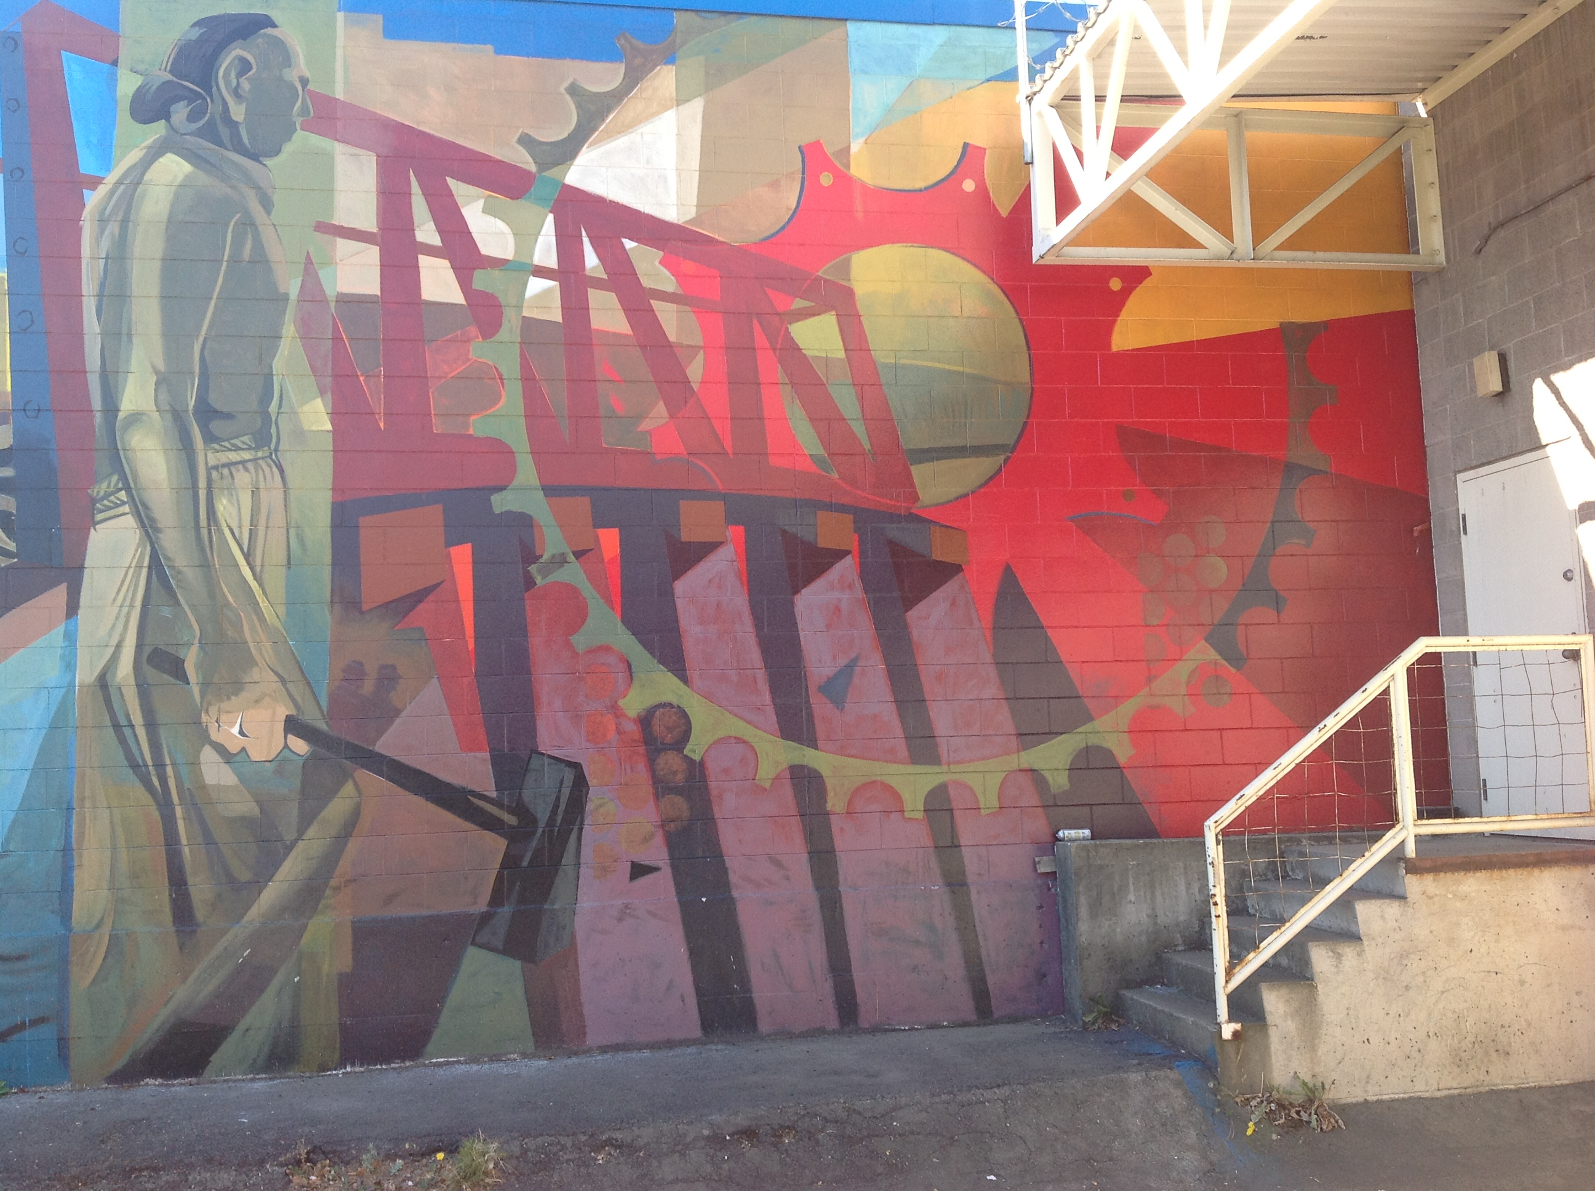
DOL TAACCCT
Advanced Manufacturing
Curricula Requests & Sharing Webinar
Wednesday March 10, 2014
10am PST
Except where otherwise noted these materials are licensed Creative Commons Attribution 4.0 (CC BY)

Slide 2
Speakers
Host/Facilitator:
Paul Stacey, Associate Director of Global Learning, Creative Commons
Feature Speakers:
Gail Whitney, Flathead Valley Community College
Brenda Perea, Colorado Community College System
Helene Mancuso. Luzerne County Community College
Sandra Campbell and Beth Wild, Tulsa Community College
Barbara Walden, Truckee Meadows Community College
Christy Harmon, Wichita Area Technical College

Slide 3
Underlying idea behind this webinar
“All successful applicants must allow broad access for others to use and enhance project products and offerings, including authorizing for-profit derivative uses of the courses and associated learning materials by licensing newly developed materials produced with grant funds with a Creative Commons Attribution License (CC BY).” TAACCCT SGA
Potential
Share development costs of learning resources among institutions
Quality improvements through collaboration, visibility, creativity, and critical thinking
Save time and effort through the reusing and remixing of resources
Pedagogical innovations
New partnerships and market opportunities
Grantee to grantee collaboration and sharing

Slide 4
TAACCCT grantees are developing curricula in shared fields of study including:
What we did to create this webinar
Manufacturing
Health
IT
Energy
Transportation
Invite TAACCCT grantees to:
Make requests for curricula they are looking for that other grantees may have developed or found a source for.
Share curricula they have developed or found that other grantees can benefit from.

Slide 5
Feature grantee requests and sharing. Invite other grantees participating in the webinar to respond with suggestions, recommendations or expressions of interest. This webinar is more of a dialogue than a presentation.
Webinar Format

Slide 6
Agenda
Part 1: Feature Speakers: Gail Whitney Flathead Valley Community College, along with Brenda Perea Colorado Community College System, Helene Mancuso Luzerne County Community College
Topic: Online advanced manufacturing curriculum (machining, electronics, industrial maintenance, welding, engineering graphics CAD and 3D, electronic engineering technology)
Part 2: Feature Speakers: Gail Whitney from Flathead Valley Community College, along with Sandra Campbell and Beth Wild from Tulsa Community College
Topic: Discussion around the use of Tooling University v Amatrol v MasterCam as online tools for simulations

Slide 7
Agenda
Part 3: Feature Speakers: Christy Harmon Wichita Area Technical College
Topic: Things we’re looking for: 1. Open blueprint textbook/ curriculum 2. Options and costs structures for online advanced manufacturing curriculum
Items to Share: 1. Manufacturing Health, Safety and Quality Courses, 2. Global Professional Studies (in progress- ready by Summer) 3. Our online platform for curriculum delivery
Part 4: Feature Speakers: Barbara Walden Truckee Meadows Community College, along with Sandra Campbell and Beth Wild from Tulsa Community College
Topic: Resources for Accelerated Welding, Production Technician (automation-industrial maintenance) and any programs that blend or include Manufacturing Skill Standards Council (MSSC) certifications - Certified Production Technician, Certified Logistics Technician

Slide 8
Agenda
Part 5: Feature Speakers: Sandra Campbell and Beth Wild from Tulsa Community College
Topic: Quality. Quality to be taught in facilities - resources for teaching quality/LEAN.
Topic: Processes related to articulations with other schools so students can transfer stackable certifications to an associates or BA.

Slide 9
Request & Share Advanced Manufacturing Topic #1
“I am looking for online advanced manufacturing curriculum (machining, electronics, industrial maintenance).”
Gail L. Whitney, Grant Director-AMAMII, Flathead Valley Community College
“Here at the TAACCCT3/CHAMP consortium (Colorado Helps Advanced Manufacturing Programs) we are looking for online advanced manufacturing curriculum (machining, electro-mechanical, welding, engineering graphics (CAD and 3D).”
Brenda Perea, TAACCCT3/CHAMP consortium (Colorado Helps Advanced Manufacturing Programs) www.cccs.edu/CHAMP
“We are looking for some basic welding curriculum.” Helene Mancuso , JobTrakPa Program Director, Luzerne County Community College

Slide 10
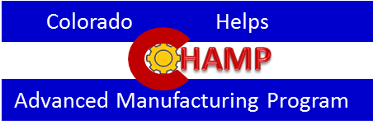
Colorado Community College System

Slide 11
The Team
Aims Community College
Front Range Community College
Community College of Denver
Emily Griffith Technical College
Front Range Community College
Lamar Community College
Metropolitan State University of Denver
Pueblo Community College
Pikes Peak Community College
Red Rocks Community College
Notes:
Colorado Helps Advanced Manufacturing Programs Consortium Colleges include:
Aims Community College
Front Range Community College
Community College of Denver
Emily Griffith Technical College
Front Range Community College
Lamar Community College
Metropolitan State University of Denver
Pueblo Community College
Pikes Peak Community College
Red Rocks Community College

Slide 12
Certificate Development
4 distinct certificate development cohort groups
Electro-Mechanical
4 Certificates with 25 Master Courses
Engineering Graphics
2 AAS degrees and 20 certificates with 94 Master Courses
Machining
2 AAS degrees and 26 certificates with 57 Master Courses
Welding
3 AAS degrees and 17 certificates
Notes:
CHAMP consortium is composed of 4 distinct certificate development cohort groups
Electro-Mechanical
4 Certificates with 25 Master Courses
Engineering Graphics
2 AAS degrees and 20 certificates with 94 Master Courses
Machining
2 AAS degrees and 26 certificates with 57 Master Courses
Welding
3 AAS degrees and 17 certificates

Slide 13
In support of the Statement of Work
Goals were to:
Develop master courses for the consortium certificates
Avoid duplication of effort when creating certificates and courses
Share courses between consortium colleges as quickly as possible
Share the workload across the consortium when creating new certificates and courses
Notes:
Goals were to:
develop master courses for the consortium certificates
Avoid duplication of effort when creating certificates and courses
Share courses between consortium colleges as quickly as possible
Share the workload across the consortium when creating new certificates and courses

Slide 14
Degrees/Certificates and Course Development Timelines
Active courses within existing certificates developed into Master courses by June 2014
New courses shared by more than 1 college for existing or new certificates by October 2014
New certificate courses by November 2014
Notes:
Degrees/Certificate and Course Development Timelines
Active courses within existing certificates developed into Master courses by June 2014
New courses shared by more than 1 college for existing or new certificates by October 2014
New certificate courses by November 2014

Slide 15
June 2014 127 Master Courses
100% Are existing courses being revised into Master Courses to be shared between consortium colleges
AEC: Architecture Engineering and Construction Management
CAD: Computer Assisted Drafting
CNG: Computer and Networking Tech
EIC: Electricity Industry and Commercial
EGT: Engineering Graphics Tech
ELT: Electronics
ENY: Energy Technology
GIS: Geography Information Systems
MAC: Machining
MAN: Management
MTE: Manufacturing Technology
PRO: Process Technology
WEL: Welding
WTG: Wind Turbine Generation
Notes:
June 2014—development of 127 Master Courses
100% Are existing courses being revised into Master Courses to be shared between consortium colleges
AEC: Architecture Engineering and Construction Management
CAD: Computer Assisted Drafting
CNG: Computer and Networking Tech
EIC: Electricity Industry and Commercial
EGT: Engineering Graphics Tech
ELT: Electronics
ENY: Energy Technology
GIS: Geography Information Systems
MAC: Machining
MAN: Management
MTE: Manufacturing Technology
PRO: Process Technology
WEL: Welding
WTG: Wind Turbine Generation

Slide 16
October 2014 63 Master Courses
33% New build courses
CAD: Computer Assisted Drafting
EGT: Engineering Graphics Tech
ENY: Energy Technology
MAC: Machining
MTE: Manufacturing Technology
WEL: Welding
Notes:
October 2014—development of 63 Master Courses in:
33% New build courses
CAD: Computer Assisted Drafting
EGT: Engineering Graphics Tech
ENY: Energy Technology
MAC: Machining
MTE: Manufacturing Technology
WEL: Welding

Slide 17
December 2014 24 Master Courses
100% New Build Certificates and Courses
MAC: Machining
MTE: Manufacturing Technology
WEL: Welding
Notes:
December 20
MAC: Machining
MTE: Manufacturing Technology
WEL: Welding
14—development of 24 Master Courses in:

Slide 18
Seeking Course Material and Resources
Swiss Turn-Intro to Advanced Manufacturing
Intro to Principles of Swiss Turn
5 Axis machining
Wire EDM
Swiss Turn I, II, III
courses for incrementally advanced levels
Quality Control and Inspection
Levels I, II, III

Slide 19
brenda.perea@cccs.edu
720.858.2855

Slide 20
Creative Commons Attribution
This Workforce Solution presentation by Brenda Perea is licensed under a Creative Commons Attribution 4.0 International License. Based on a work created under the Department of Labor, TAACCCT3 grant, permissions beyond the scope of this license may be available at http://www.cccs.edu/partnering-for-success/trade-adjustment-assistance/taa-champ.

Slide 21
Request & Share Advanced Manufacturing Topic #2
“A discussion around the use of Tooling U vs. Amatrol vs. MasterCam as the online tools for simulators would be worthwhile.”
Gail L. Whitney, Grant Director-AMAMII, Flathead Valley Community College, and
Sandra Campbell program development specialist at Tulsa Community College working with Beth Wild.
http://www.toolingu.com
http://www.amatrol.com
http://www.mastercam.com/

Slide 22
Request Advanced Manufacturing Topic #3 & 5
“Things we’re looking for:
Open blueprint textbook/ curriculum
Options and costs structures for online advanced manufacturing curriculum”
“Items to Share:
a. Manufacturing Health, Safety and Quality Courses
b. Global Professional Studies (in progress- ready by Summer)
c. Our online platform for curriculum delivery”
Christy Harmon PHR, NAC Grant Project Coordinator, Wichita Area Technical College, National Center for Aviation Training

Slide 23
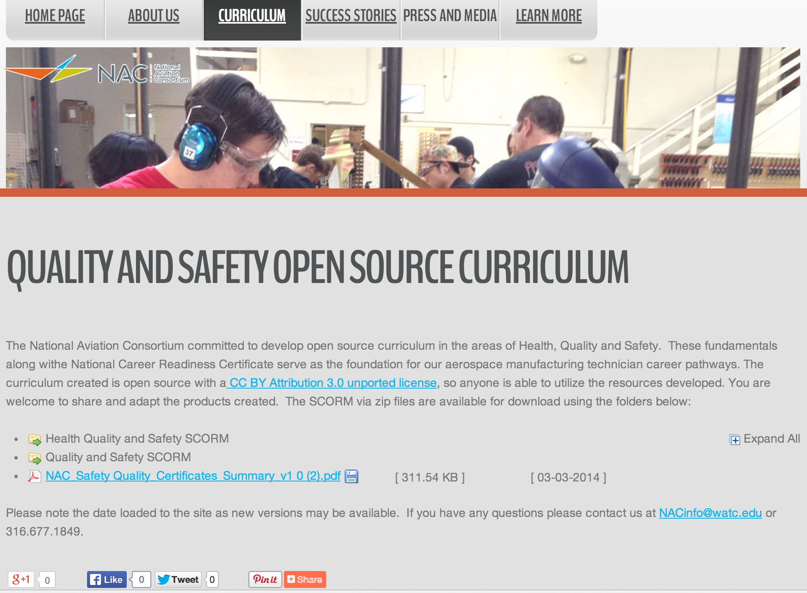
Sharing Advanced Manufacturing Topic #5
http://www.naccareers.com/curriculum/open-source-curriculum

Slide 24
Request & Share Advanced Manufacturing Topic #4
“"We are interested primarily in Manufacturing areas. Specifically, Accelerated Welding, Production Technician (automation-industrial maintenance) and any programs that blend or include Manufacturing Skill Standards Council (MSSC) certifications."
Barbara Walden, Grant Projects Manager, Truckee Meadows Community College
'We would like to submit a request for logistics-related curricula (other than MSSC CLA/CLT). Most of the other logistics/supply chain certificates out there seem to be geared for folks already holding degrees in supply chain management (or something related). In addition, we recently reviewed the emerging profession of Supply Chain Technician, and would like to know if others are utilizing a similar educational track.
Stephen M. Long, Associate Vice Chancellor, Workforce Solutions, St. Louis Community College

Slide 25
Request & Share Advanced Manufacturing Topic #4
“We are beginning our program (Feb 11) and teaching the 4 modules of Certified Production Technician. We will use the online course material, the textbook, instructors, CPT activities and add hands-on along with industry partners coming in to talk to the students and site visits to companies. These classes will run 16 weeks; they are worth 12 credit hours at Tulsa Community College and the students can take the National Certified Production Technician Certification Tests after each module. We need to be thinking about another or next level but feel right now that the basic, ground knowledge of the CPT will benefit the student and industry.
Sandra Campbell-program development specialist at Tulsa Community College

Slide 26
Request Advanced Manufacturing Topic #5
“Paul, I forgot to ask if anyone out there in Manufacturing has done articulations with other schools and what their process/papers/requests or need to do at all looked like? We are needing to set up a few with our local Technology School since they have all the CNC machining equipement plus much more and then with some Univ. in the area so students can transfer their stackable certifications to an associates and then advance to a BA and maybe even further on up the ladder.”
“We have had several requests for Quality to be taught in facilities--we have materials but maybe there is someting newer? More up to date? Online? In the quallity/LEAN area?”
Sandra Campbell program development specialist at Tulsa Community College working with Beth Wild

Slide 27
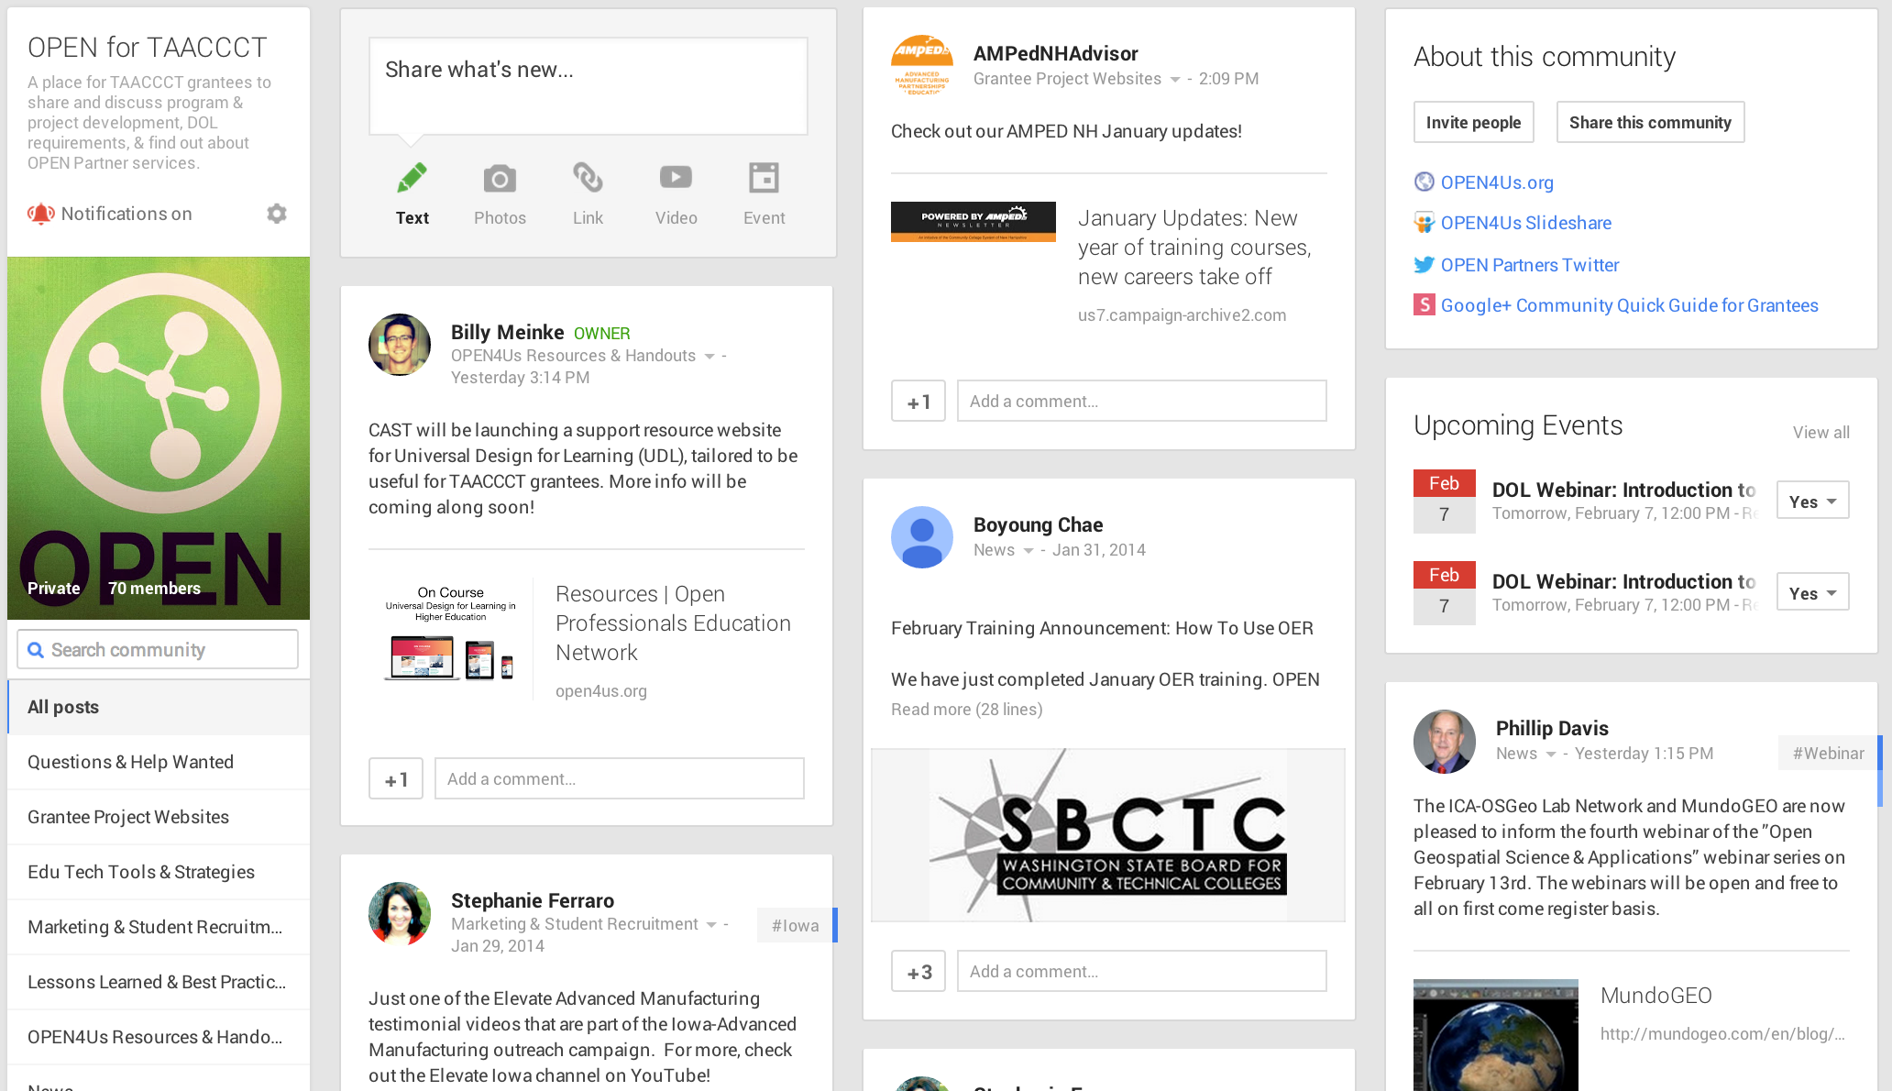
http://open4us.org/
http://bit.ly/1iw1sTf

Slide 28
DOL TAACCCT
Advanced Manufacturing
Curricula Requests & Sharing Webinar
THANKS
Except where otherwise noted these materials are licensed Creative Commons Attribution 4.0 (CC BY)

